Slide 1
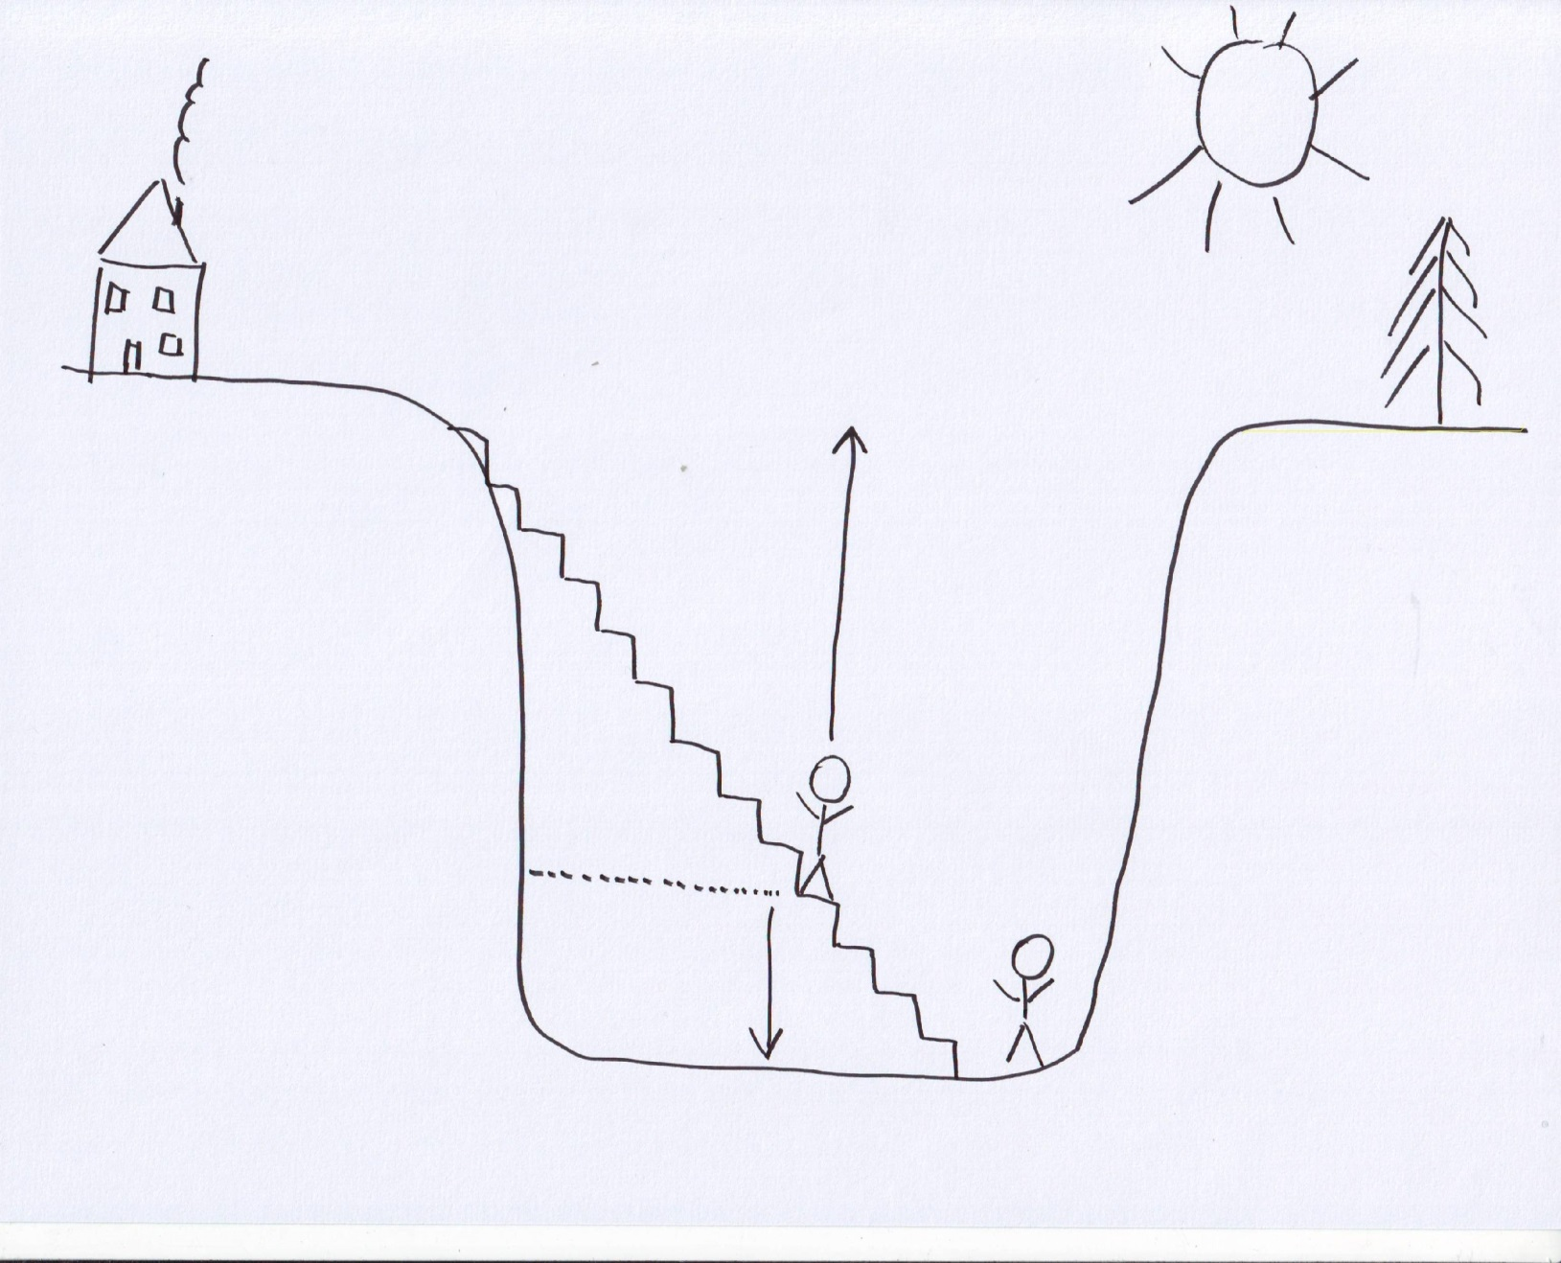
Graphic: Deep Hole:
Motivation for engagement
Revaluation of the expectation of success
Assessment of progress:
Less motivating:
„how far away is my original strength?“
Assessment of progress:
More motivating:
„how far did I get already?“

